Slide 1
HELO PRIME
Snake

Slide 2
Team members
Tsvetina Georgieva – movement logic, project manager (urging us to code faster ☺)
Daniel “ThePeshMod” Dyankov – collision logic, initial project plan
Stanislav “sisk0” Bozhilov – JFrame drawing
Daniel Tsonkov – research; how other people do such games ☺ Everyone – lots of debugging, refactoring, and trying to setup GitHub properly.

Slide 3
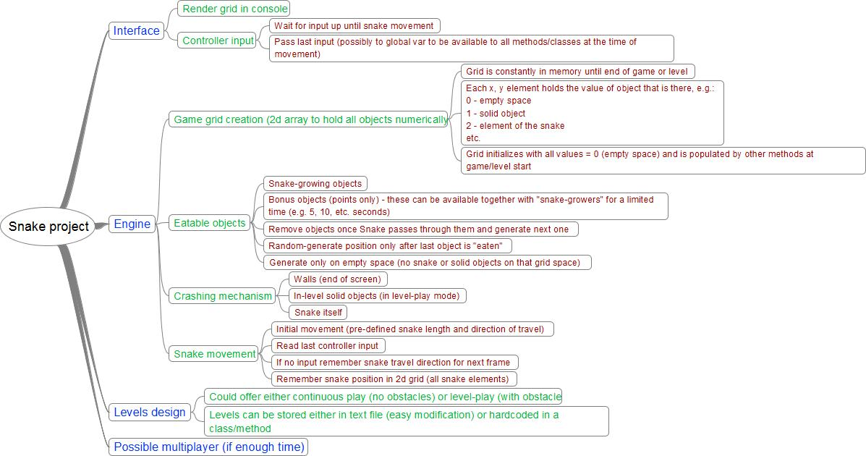
Initial project plan

Slide 4
Collaboration tools used
GitHub: https://github.com/ThePeshMod/JavaIntroTeamProject All code is committed to the GutHub, all commit conflicts resolved between the team members.
Skype & Facebook For talking ☺

Slide 5
Classes
Game.java - holds the main methods necessary for the game
Globals.java – holds our global variables
DrawGame.java – draws out the console using JFrame

Slide 6
Logic (simplified)
We keep the snake head position and snake parts in Point objects
On every ‘move’ the head is moved according to the current direction (EAST, WEST, NORT, SOUTH)
A check is performed whether it hits a wall or apple or nothing
IF apple is hit, snakeLength++, score++, etc.
IF empty space, remove one point from snakePoints (x, y Point array)
IF wall or snakePoint, set gameOver = true
Game speed increases every 10 points

Slide 7
Thank you for your attention! ☺

